Slide 1
Training Methods in Human Resource Management
Name:- Bhagyashree malviya

Slide 2
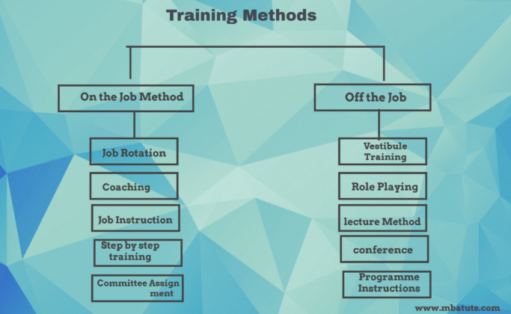
As a result of research in the field of training, a number of programs are available some among these are new methods while others are improvements over the traditional methods.

Slide 3
On the job training methods
This type of training also known as job instruction training this is most commonly used as a method. Under this method, the individual is placed on a regular job & taught the skills necessary to perform the job.
Following are the job training methods.
Job Rotation 2. Coaching
3. Job Instruction 4. Committee Assignment

Slide 4
1. Job Rotation
It involves the movement of the trainee from one job to another. The trainee receives job knowledge & gains experience from his supervisor or trainer. This type of training gives an opportunity to the trainee to understand the problem of employees on other jobs & respect them.

Slide 5
2.Coaching
The trainee is placed under a particular supervisor who functions as a coach in training the individual. The supervisor provides feedback to the trainee on his performance & offers him some suggestions for improvement.

Slide 6
3.Job Instruction
This method is also known as step by step training. Under this method, the trainer explains to the trainee the way of doing the jobs, knowledge & skill and allows him to do the job. The trainer appraises the performance, provides information & corrects the trainees.

Slide 7
4. Committee Assignment
Under this method, a group of trainees is given and asked to solve an actual organization problem. The trainees solve the problem jointly and develop teamwork.

Slide 8
Off the job training methods
Under this method of training, the trainee is separated from the job situation and his attention is focused on learning the material related to his future job performance.
Following are the job training methods.
Vestibule training 2. Role-Playing
3. Lecture Method 4. Conference
5. Programmed Instructions

Slide 9
1.Vestibule training
In this method, actual work conditions are simulated in a classroom. Material files and needed equipment are also used in training. This type is used for training personnel for clerical and semi-skilled jobs.

Slide 10
2 Role-Playing
It is defined as a method of human interaction that involves realistic behavior in an imaginary situation. This method of training involves action doing the practice. This method is mostly used for developing inter-personal interaction and relations.

Slide 11
3. Lecture Method
The lecture is a traditional & direct method of instruction. The instructor organizes the material & gives it to a group of trainees in the form of a talk. This is beneficial to train a large group of trainees.

Slide 12
4. Conference
It is a method for clerical, professional & supervisory personnel. This involves a group of people who put forth ideas, examine & share facts, ideas assumptions & draw a conclusion..the success of this method depends on the leadership qualities of the person who leads the group.

Slide 13
5.Programmed Instructions
In recent years this method has become popular the subject matter to be learned is presented in a series of carefully planned sequential .this method is expensive & time-consuming.

Slide 14
Thank You ☺

